Slide 1
Course Introduction Grade 8 Socials
Miss Ball

Slide 2
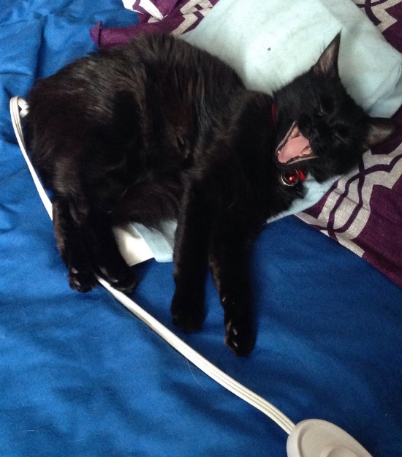
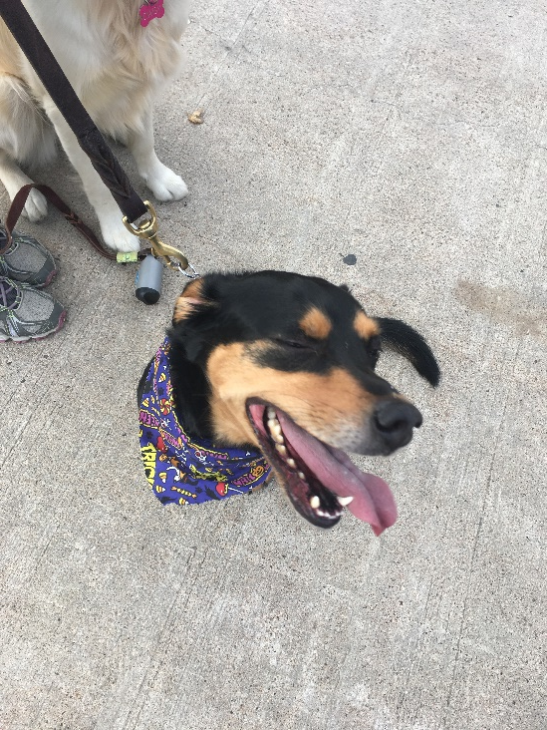
Introduction
Miss Raylene Ball
Teacher at Villanova since 2002
Teach Grade 7 and Grade 8 Socials
Socials Department Head (9 years)
Organizer of the Grade 8 Farewell
I have 2 rescue animals - Morgan
and Rosie.

Slide 3
Welcome to Grade 8 Socials!
The theme for Grade 8 curriculum is “history as a story of the past in the present”.
We look at:
1) history as a lens to the past,
2) history as a story of people,
3) history as a story of events
4) history as a story of change.

Slide 4
Topics
The course introduces students to the history of the province from our earliest inhabitants to Newfoundland and Labrador becoming a part of Canada in 1949. The focus is on the 1800s (19th Century).
Topics include:
First Nations and European settlers
The Fisheries
Lifestyles in the 1800s
World War 1 and 2
Confederation with Canada

Slide 5
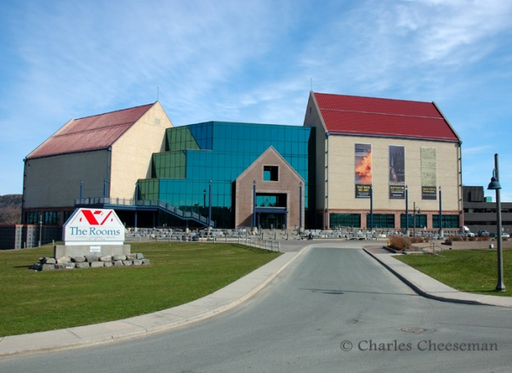
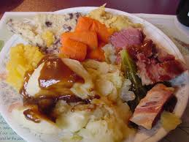
Assignments and Activities
Artifact presentation (first assignment)
Field trips
Cooking traditional recipes
Drawing a picture of a historic event,
Creating video stories on historic events
Research project on some aspect of our
province

Slide 6
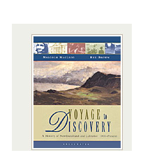
Unit Information
Textbook:
Voyage to Discovery
Units of Study:
There are 11 chapters broken into 4 units.
Each unit is worth a certain percent of
the students overall mark.

Slide 7
EVALUATION
Unit One : Introduction: History as a Lens to the Past | 10%
Unit Two : Newfoundland and Labrador from the Turn of the 19th Century through to the Early 20th Century: History as a Story of People | 33%
Unit Three: Newfoundland and Labrador from 1914 through 1949: History as a Story of Significant Events | 31%
Unit Four: Newfoundland and Labrador through the 2nd Half of the 20th Century: History as a Story of Change | 26%
Unit Five: Integrated | Included throughout

Slide 8
Sample Evaluation for a Unit of Work
Unit Two: 33% Unit Two consists of 4 chapters: Chapter 2, 3, 4 and 5. | Within Unit Two you may have 3 minor assignments, 2 major assignments, a quiz and 2 tests.

Slide 9
Socials Research Project
The socials research project is a visual representation of some aspect of Newfoundland and Labrador history and/or culture.
The project incorporates the research outcomes of the course. (SCO 1.1/ SCO 1.2) and will count as part of the assessment for Unit One.
Unlike previous years, there will be just a visual/text component and no oral presentation.This will be done through Google slides or a backboard display.
The exception to this is for those students who wish to be considered for the Regional Heritage fair. These students must do backboard display and present to a panel of teachers.

Slide 10
Materials
Pencil
Red binder (1-1.5 inch) – has to be this colour
Exercise or loose-leaf
Earbuds

Slide 11
Google Classroom
Most teachers here at VJH use Google classroom now to post classwork in, including assignments.
Students will also be regularly using Chromebooks during class time to complete work.
It will be important that your child is signed into their classroom for their subject. Students have been given a code that is also posted on the homework page.
It is also important that your child is regularly checking their course Google classrooms for study guides, notes etc.

Slide 12
PowerSchool
An important tool to let you have a part in your children’s education.
Allows not only to see marks but comments from teachers regarding assignments.
Lets you know if your child has not submitted an assignment or was late submitting one.
Especially important given the late assignment policy.
Accessed through school webpage or the NLESD website under the “Parents” tab

Slide 13
Important Links
http://missrayleneball.weebly.com/
www.villanovahw.ca/index.php
https://twitter.com/VillanovaSchool

Slide 14
Student Responsibilities
Students are expected to:
Treat myself , themselves and others with respect
Be a part of creating a positive safe environment
To be on time
Bring all materials
Give their best effort
Do all course work and check google classroom, homework page

