Slide 1
Course Introduction Grade 8 Socials
Miss Ball 2016-2017

Slide 2
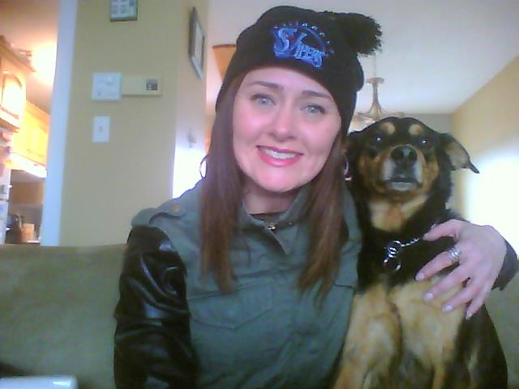
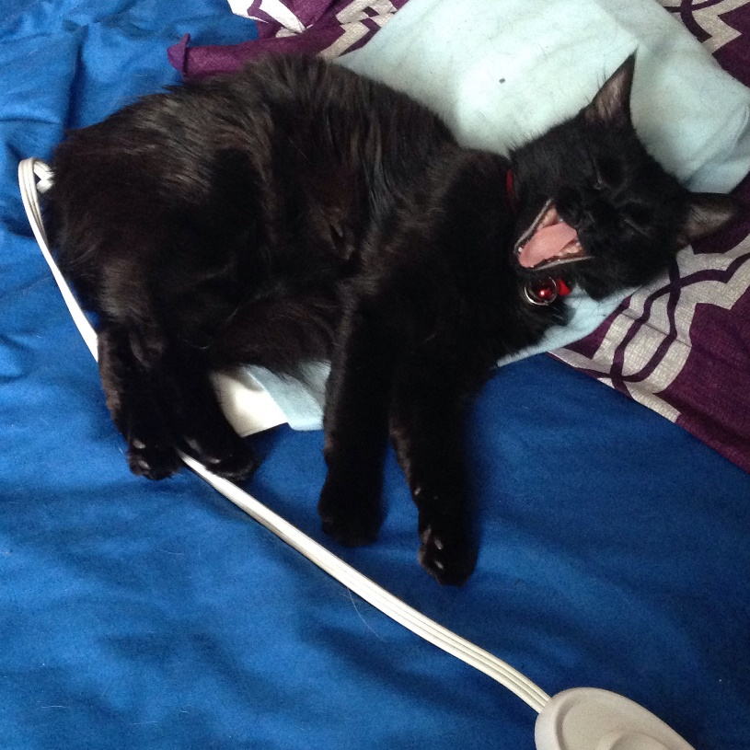
Introductions
- Miss Raylene Ball
- Teacher at Villanova since 2002
- Teach Grade 7 and Grade 8 Socials
- Socials Department Head (7 years)
- Cheer coach (8 years)
- Organizer of the Grade 8 Farewell
- Live in Paradise, grew up in
St. John’s
- “Rescue Mom” to Morgan and Rosie
- Aunt to Riley

Slide 3
Welcome to Grade 8 Socials!
The theme for Grade 8 curriculum is “history as a story of the past in the present”.
The curriculum examines various themes related to the history of Newfoundland and Labrador :
1) history as a lens to the past,
2) history as a story of people,
3) history as a story of events
4) history as a story of change.

Slide 4
Topics
The course introduces students to the history of the province from our earliest inhabitants to Newfoundland and Labrador becoming a part of Canada in 1949. The focus is on the 1800s (19th Century).
Topics include:
First Nations and European settlers
The Fisheries
Lifestyles in the 1800s
World War 1 and 2

Slide 5
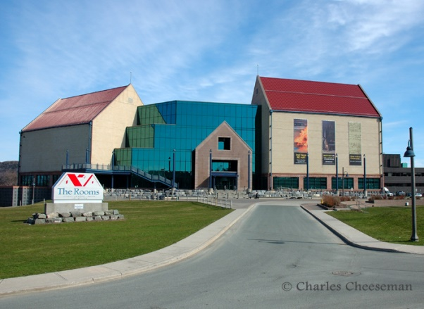
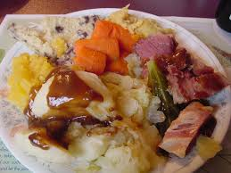
Assignments and Activities
artifact presentation (first assignment)
field trips
Heritage Fair
cooking traditional recipes
drawing a picture of a historic event,
web quest,
creating power points or video stories on historic events
Using Nearpod

Slide 6
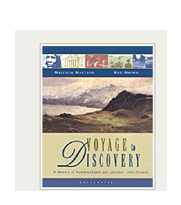
Chapter Information
Text:
Voyage to Discovery
Units of Study:
Chapter One: History and the Historian
Chapter Two: The People Who Lived Here
Chapter Six: The First World War
Chapter Five: Lifestyles in the Nineteenth Century
Chapter Three : Making a Living in the Nineteenth Century
Chapter Eight: The Second World War
Chapter Nine: Moving Towards Confederation

Slide 7
Evaluation
Tests/Quizzes: 40%
Heritage Fair: 20%
Major Projects and activities 25%
Minor Projects and activities 10%
Journals 5%
There is usually a test and an assignment for each chapter. The test/homework/ evaluation policy is applied to all Social Studies evaluation. Details on the Heritage Fair will be forthcoming in late September/early October.

Slide 8
Powerschool
An important tool to let you have a part in your children’s education.
Allows not only to see marks but comments from teachers regarding assignments.
Lets you know if your child has not submitted an assignment or was late submitting one.
If you don’t have one, please see Mr. Jenkins at the office.
Accessed through school webpage or the NLESD website under the “Parents” tab

Slide 9
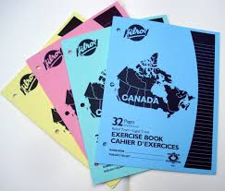
Materials:
Pencil
Exercise (for journals)
Duotang or binder
Cannot use big multi-subject binder because collecting in duotangs!
Ziplock - optional

Slide 10
Heritage Fair: What is it?
The Heritage Fair is a visual and text representation of some aspect of Newfoundland and Labrador history and/or culture. A class presentation is part of this process. This can be done individually or with a partner.
The Heritage Fair incorporates the research outcomes of the course. (SCO 1.1/ SCO 1.2)

Slide 11
Heritage Fair
The Process:
1) Pick a topic (Approval from teacher)
2) Research gathered (2-3 LRC days are given) and an outline filled out
3) Outline submitted to teacher along with sources
4) Outline is passed back in a week with feedback about how to improve project
5) Final project is submitted (backboard/powerpoint)
6) In class oral presentation

Slide 12
Responsibilities of Miss Ball
As your child’s teacher I will:
Treat your child with respect
Provide quality instruction
Give feedback (ex. on tests)
Provide extra help as needed
Give fair grades
Create a positive and safe environment
Give my best effort everyday
Keep in communication

Slide 13
Student Responsibilities
Students are expected to:
Treat myself and classmates with respect
To be on time
Bring all materials
Give their best effort
Do all course work and check homework page
Follow Miss Ball’s procedures
Be a part of creating a positive safe environment

Slide 14
Online resources
www.missrayleneball.weebly.com
http://www.villanovahw.ca/index.php
https://twitter.com/VillanovaSchool

