Slide 1
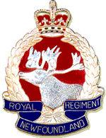
Beaumont Hamel and the Royal Newfoundland Regiment
Better Than The Best
Notes:
‹#›
On the front page, notice the crest and the words “ Better than the best”
Questions: Why not a moose? Not native to the province, the caribou is.
Question: Do you know what the phrase is? A motto. The moto of the Newfoundland Regiment.

Slide 2
Beaumont Hamel

Slide 3
Beaumont Hamel
On July 1st, 1916 the Regiment fought the Battle of Beaumont Hamel against the Germans.
Beaumont Hamel is a small town in France.
This part of a larger battle called the battle of the Somme.
At 9:15 a.m., 801 men from the Royal Newfoundland Regiment went into that battle.
How many answered roll call next morning??

Slide 4
68

Slide 5
Beaumont Hamel
The Battle only lasted 30 minutes.
The men had been ordered out at walking pace across No Man's Land
The space between the front lines of the opposing forces. To get to the enemy line, soldiers crossed over into “No Man’s Land.”

Slide 6
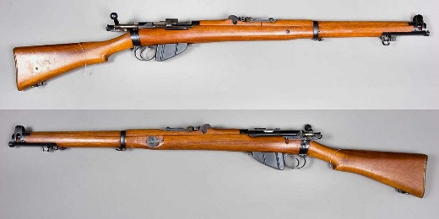
The Newfoundlanders were using .303 Lee Enfields.
The Germans were using machine guns

Slide 8
Beaumont Hamel by the numbers
801 went into battle
233 died
91 were missing
386 wounded
68 answered roll call

Slide 9
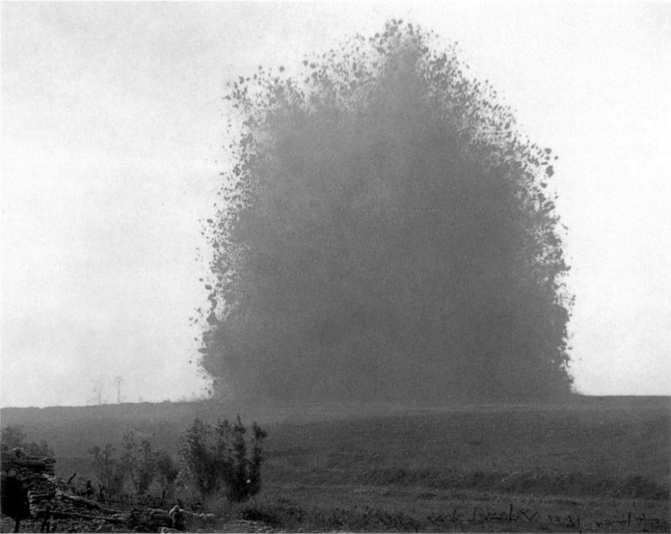
Why did it go so wrong??
1) The Hawthorne Ridge explosion: The British set off a 20, 000 kg mine under German fortifications. However, instead of harming the Germans it warned them of the coming attack and allowed them to set up for battle.

Slide 10
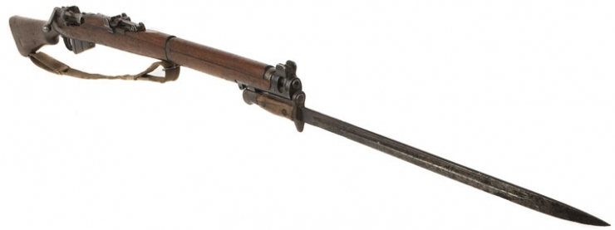
2) Weaponry: The Newfoundland Regiment were armed with rifles and were trained in the use of bayonets and hand-hand combat. This was no match for the Lewis guns used by the Germans. Newfoundlanders were mowed down as they crossed No Man's Land.

Slide 11
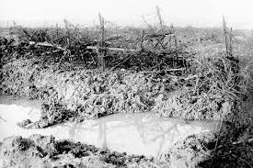
3) Field conditions: The Regiment had to contend with both mud and barbed wire as they tried to cross No Man's Land. The British had shelled the area heavily about a week before. However it didn't cause the damage that was anticipated and many men got caught up. The Germans trained their guns on the gaps in the wire that had been created.

Slide 12
Beaumont Hamel today: Aerial view

Slide 13
The Trenches

Slide 14
Why is this Battle so Important?
Loss of life and limb: Over 700 soldiers either died or were wounded. With such a small population, many families were directly effected. They lost brother's, fathers, sons etc. or ended up having to care for injured family members who could no longer work.

Slide 15
Economic: many of the men that were members of the workforce were now either dead or injured. Severely injured men had to be taken care of by the government and by their families. In the end the war cost Newfoundland altogether millions of dollars.

Slide 16
Bravery: It was an incredible display of courage, that only failed because "dead men can advance no further” (pg. 131 for quote from General Beauvoir de Lisle). Even though they knew their fate, they continued in their efforts to defeat the enemy. They paid the ultimate sacrifice in their bid to achieve freedom.

Slide 17
The Supreme Sacrifice
By the end of World War One, 6241 men had served in the regiment.
Almost one quarter of Newfoundlanders and Labradorians in the military died during WW1.
That represents almost 2000 men, most of them between ages 19 and 36.

Slide 18
Book of Remembrance
To remember the people who died fighting “for king and country”, a Book of Remembrance was made.
There are copies at Memorial University, Mile One Stadium, and the Peace Tower in Ottawa.
There is even a copy on the Veterans Affairs Canada website:
http://www.vac-acc.gc.ca/
Notes:
‹#›
How did that impact Newfoundland? Loss of young men, husbands, sons, fathers. Man single parent households. Women had to continue doing men's’ work along with their own.

Slide 19
A National War Memorial
Another Form of
Remembrance
Unveiled in St. John’s on 1 July, 1924
When was the first Memorial Day held here in Newfoundland?
July 1st, 1917

Slide 20
June 27th, 1925 Ther Beaumont Hamel park opens in France

Slide 21
Honour and Valour

